Slide 1
OpenStudio SDK
Tips and Tricks for Easier Modeling with Ruby Scripts
Eric Ringold
kW Engineering

Slide 2
Objectives
Why?
Introduction to Ruby
What it is
How to get it
Key features
Introduction to OpenStudio SDK
What it is
How to get it
Keu features
Model edit demo

Slide 3
Why?
Rapid, consistent model creation, editing, auditing

Slide 4
Why?
Rapid, consistent model creation, editing, auditing
Let the computer do tedious stuff

Slide 5
Why?
Rapid, consistent model creation, editing, auditing
Let the computer do tedious stuff
Build custom tools

Slide 6
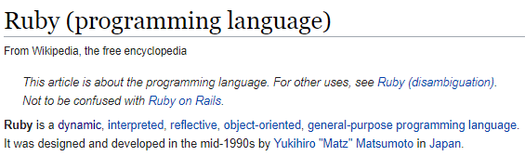
Ruby – Language
Object – oriented:
Everything is an Object, i.e. instance of a Class
Objects have:
- Attributes (data)
Methods (actions/functions): object.method
Inheritance (relationships)
Interpreted: no compiler
Reflective: can modify it’s own structure + behavior
General-purpose: use for many things

Slide 7
Ruby – Useful Classes/Data Types
String
“Office_301”
Integer, float
16, 12.334
Array
[“List”, “of”, items, 3]
Hash
{key => value, “key”=> 3.9}
Bool
false

Slide 8
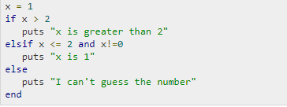
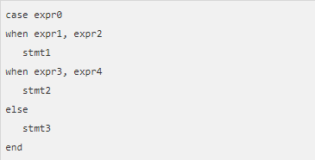
Ruby – Conditionals
If-else:
Case-when:
https://www.tutorialspoint.com/ruby/ruby_if_else.htm

Slide 9

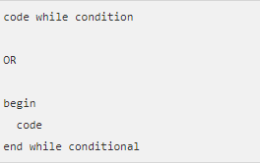
Ruby – Looping
https://www.tutorialspoint.com/ruby/ruby_loops.htm

Slide 10

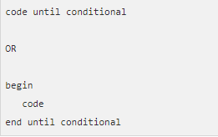
Ruby – Looping
https://www.tutorialspoint.com/ruby/ruby_loops.htm

Slide 11
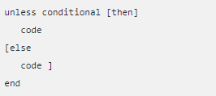

Ruby – Looping
https://www.tutorialspoint.com/ruby/ruby_loops.htm
https://www.tutorialspoint.com/ruby/ruby_if_else.htm

Slide 12

Ruby – Iterators

Slide 13

Ruby – Iterators: Array

Slide 14
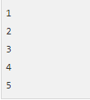
Ruby – Iterators: Array

Slide 15
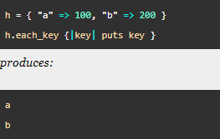
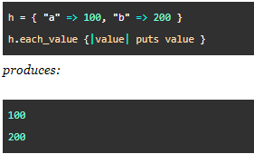
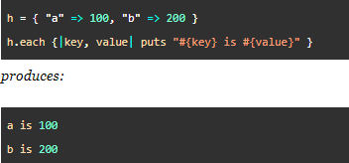
Ruby – Iterators: Hash

Slide 16
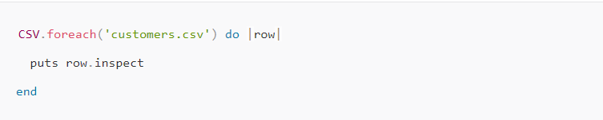
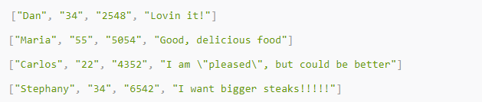
Ruby – Useful Libraries
CSV – comma-separated values
https://www.sitepoint.com/guide-ruby-csv-library-part/

Slide 17
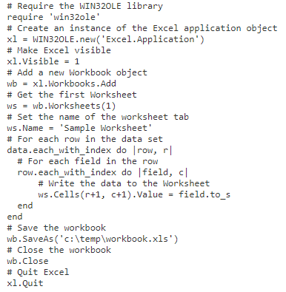
Ruby – Useful Libraries
WIN32OLE – Windows Object Linking & Embedding

Slide 18
OpenStudio Software Development Kit (SDK)
OpenStudio Model:
“a hierarchical, object-oriented model of a partial or complete building that exists to support annual energy and other simulations and related analyses”
OpenStudio SDK: way of programmatically accessing OpenStudio Model

Slide 19
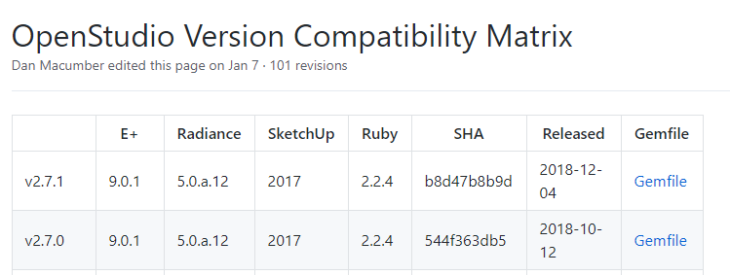
OpenStudio SDK - Installing
https://github.com/NREL/OpenStudio/wiki/OpenStudio-Version-Compatibility-Matrix

Slide 20

OpenStudio SDK - Installing
https://github.com/NREL/OpenStudio/wiki/OpenStudio-Version-Compatibility-Matrix
https://rubyinstaller.org/downloads/archives/

Slide 21
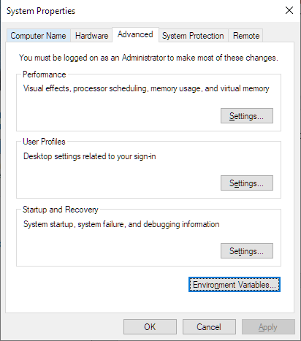
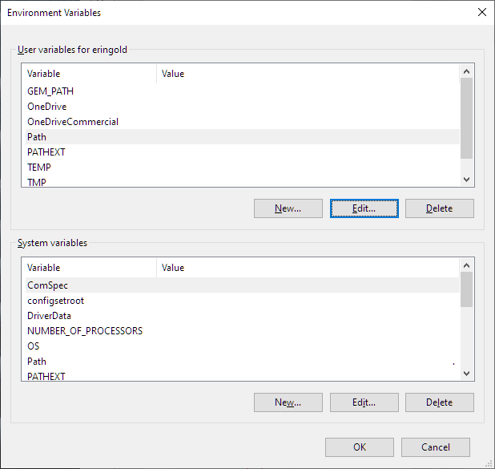
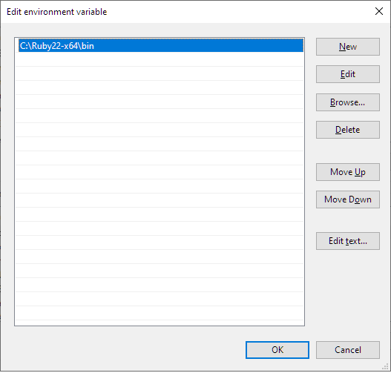
OpenStudio SDK - Installing
Add Ruby installation to PATH environment variable

Slide 22
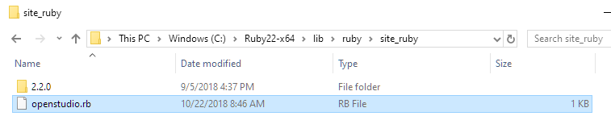

OpenStudio SDK - Installing
Link OpenStudio to Ruby installation

Slide 23
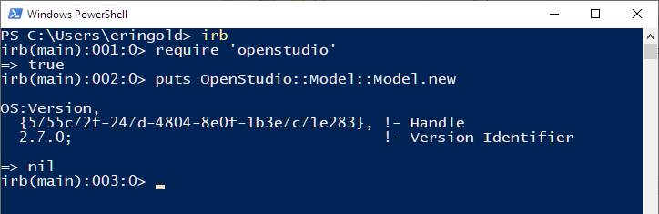
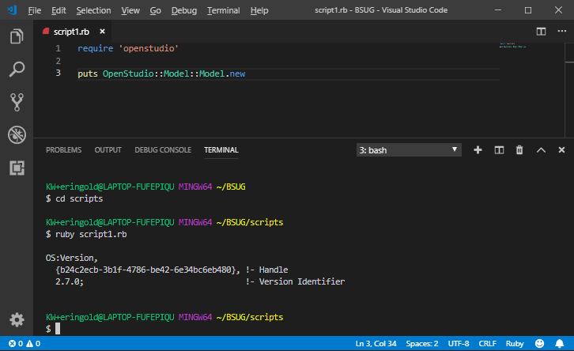
OpenStudio SDK – Using
Interactive Ruby (IRB):
Text Files:

Slide 24
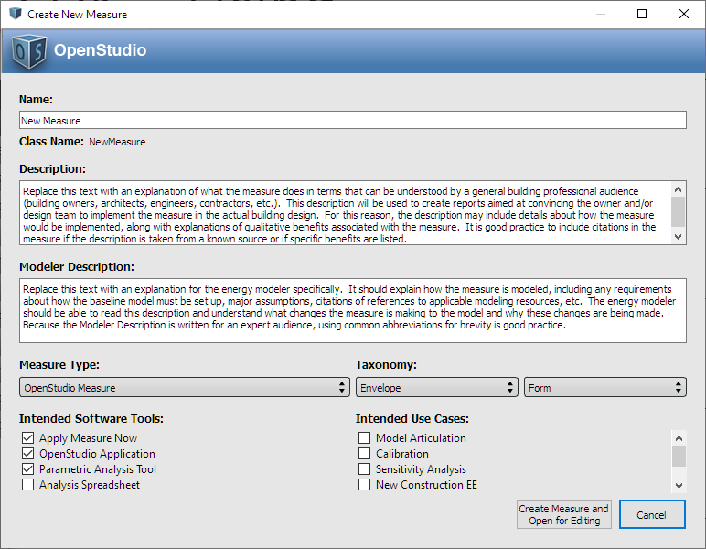
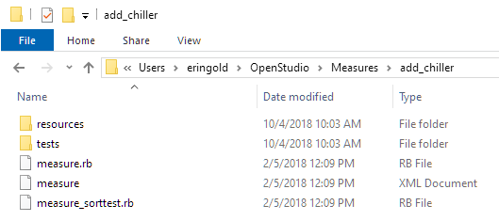
OpenStudio SDK – Using
Measures: framework for executing Ruby code in OpenStudio/PAT

Slide 25
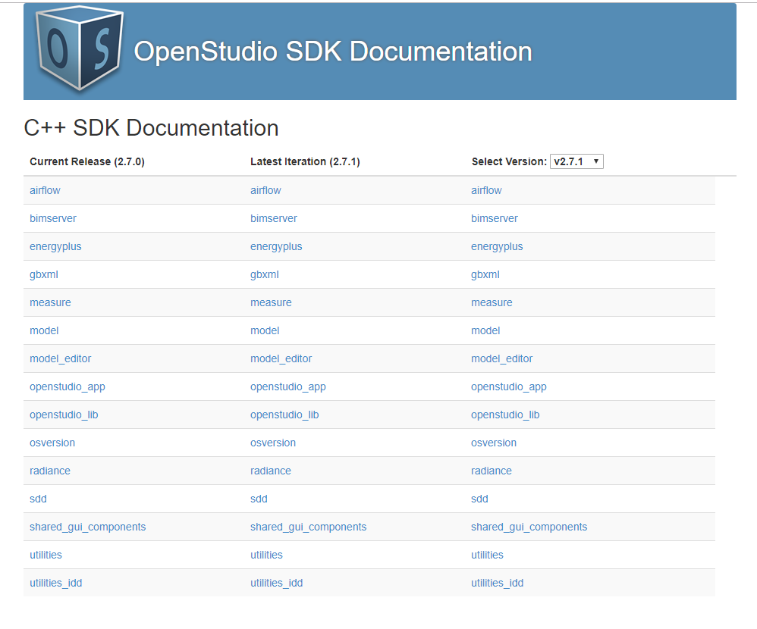
OpenStudio SDK – Reference

Slide 26
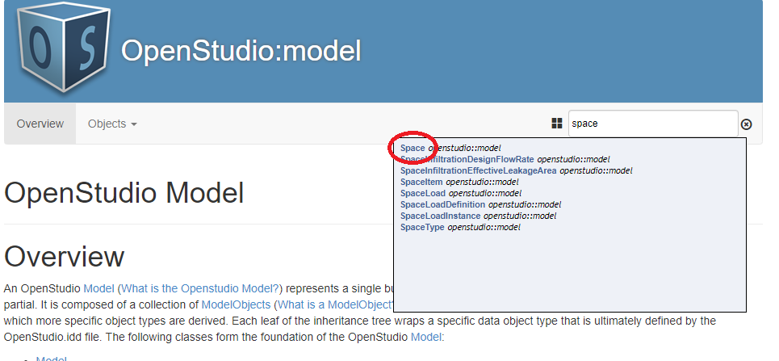
OpenStudio SDK – Reference

Slide 27
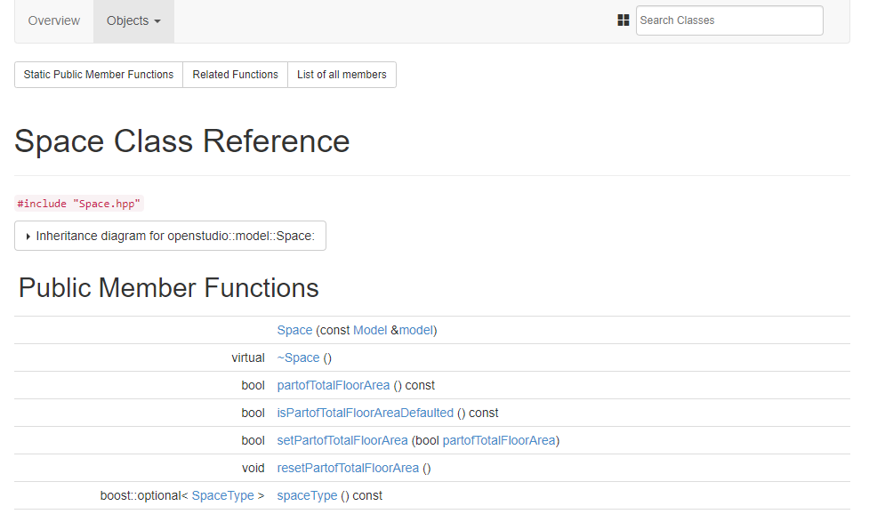
OpenStudio SDK – Reference

Slide 28
OpenStudio SDK – Reference
Class methods

Slide 29
OpenStudio SDK – Reference
Method input argument

Slide 30
OpenStudio SDK – Reference
Method output type

Slide 31
OpenStudio SDK – Reference
Class inheritance

Slide 32
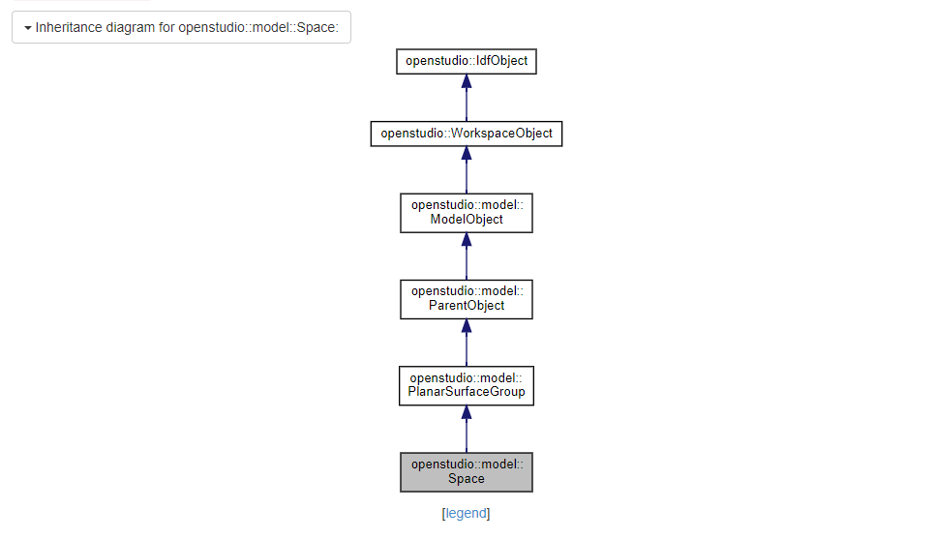
OpenStudio SDK – Reference

Slide 33
OpenStudio SDK – Reference
All inherited methods

Slide 34
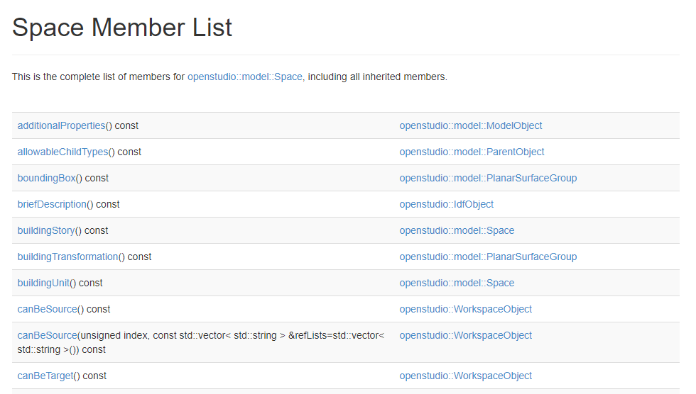
OpenStudio SDK – Reference

Slide 35
OpenStudio SDK – Reference
Methods

Slide 36
OpenStudio SDK – Reference
Methods
Inheriting Class

Slide 37
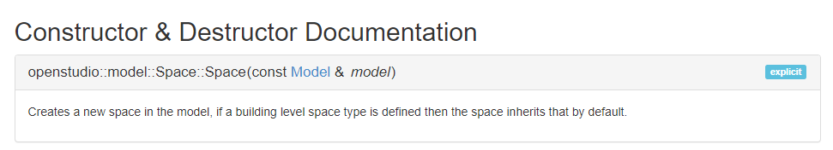
OpenStudio SDK – Reference

Slide 38
OpenStudio SDK – Reference
OpenStudio::Model::Space

Slide 39
OpenStudio SDK – Reference
.new
OpenStudio::Model::Space.new

Slide 40
OpenStudio SDK – Reference
Input object
.new
OpenStudio::Model::Space.new(model)

Slide 41
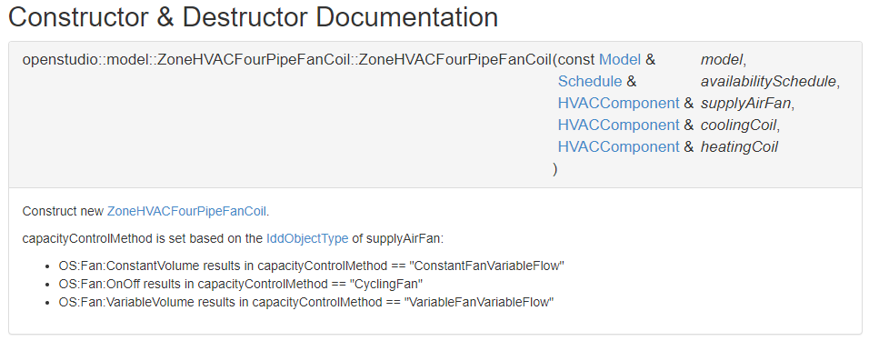
OpenStudio SDK – Reference
Input objects
.new
OpenStudio::Model::ZoneHVACFourPipeFanCoil.new(model, schedule, fan, cooling_coil, heating_coil)

Slide 42
OpenStudio SDK – Getting
To get existing model objects:
model.get[ObjectType]s
model.getThermalZones => vector (array) of ThermalZone objects in model
model.getCoilCoolingWaters => vector (array) of Coil:Cooling:Water objects

Slide 43
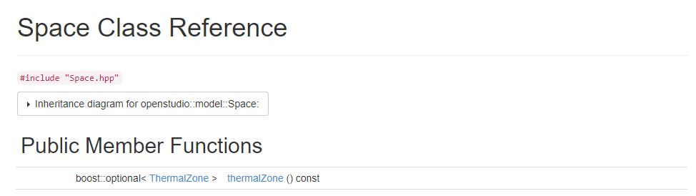
OpenStudio SDK – ‘Optional’
‘optional’ return type: thermal zone might not exist!

Slide 44
OpenStudio SDK – ‘Optional’
‘optional’ return type: thermal zone might not exist!
Need to check if ‘initialized’, then ‘get’:
zone = space.thermalZone
if zone.is_initialized
zone = zone.get
end
Otherwise:

Slide 45
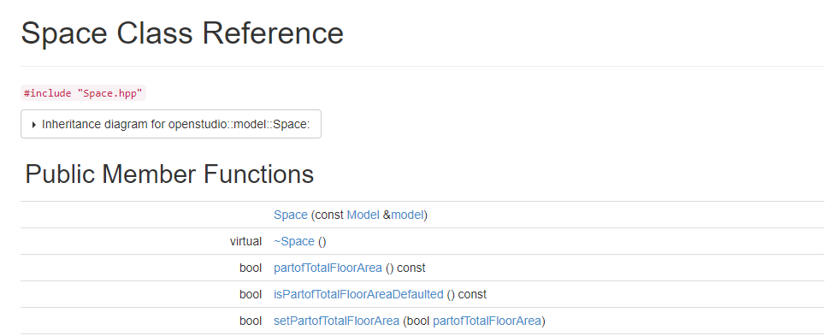
OpenStudio SDK – Setting
‘set’ method

Slide 46
OpenStudio SDK – Setting
‘set’ method
Thing to set

Slide 47
OpenStudio SDK – Setting
‘set’ method
Thing to set
space.setPartofTotalFloorArea(true)

Slide 48
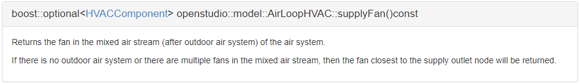
OpenStudio SDK – Casting
Want to edit the fan on an Air Loop:
Not a Fan object!

Slide 49
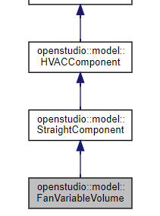
OpenStudio SDK – Casting
Want to edit the fan on an Air Loop:
Not a Fan object!

Slide 50
OpenStudio SDK – Casting
Want to edit the fan on an Air Loop:
Not a Fan object!
To turn this…
…into this…

Slide 51
OpenStudio SDK – Casting
Want to edit the fan on an Air Loop:
Not a Fan object!
To turn this…
…‘cast’ with ‘to_[ObjectType]’, which WILL RETURN OPTIONAL:
fan = air_loop.supplyFan
if fan.to_FanVariableVolume.is_initialized
fan = fan.to_FanVariableVolume.get
end
…into this…

Slide 52
Demo!

